Slide 1

Sustainable Development
Dr Jyoti K Sharma, Professor & Head
Center for Environmental Sciences & Engineering,
School of Natural Sciences

Slide 2
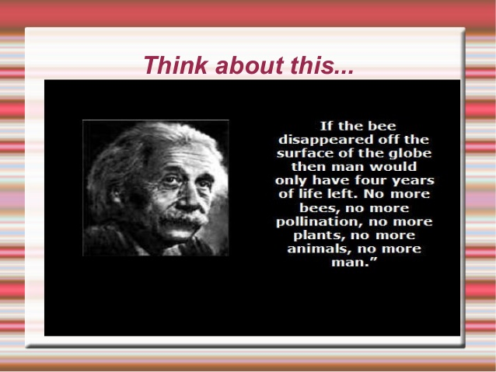


Slide 3
Sustainability
Sustainability can be defined as the practice of maintaining processes of productivity indefinitely—natural or human made—by replacing resources used with resources of equal or greater value without degrading or endangering natural biotic systems.
Sustainability can be defined as the practice of reserving resources for future generation without any harm to the nature and other components of it.

Slide 4
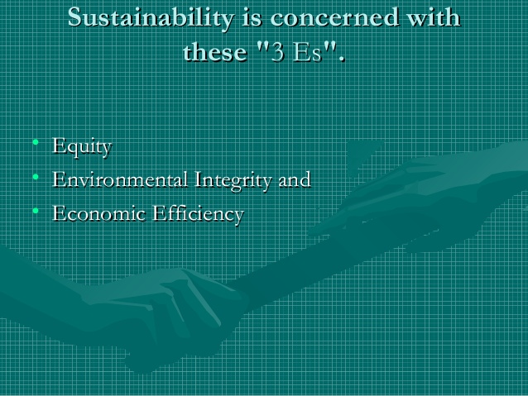

Slide 5
Sustainability & Sustainable Development (SD)
Sustainability science is the study of the concepts of sustainable development and environmental science.
There is an additional focus on the present generations' responsibility to regenerate, maintain and improve planetary resources for use by future generations.
Sustainable development ties together concern for the carrying capacity of natural systems with the social, political, and economic challenges faced by humanity.

Slide 6
Sustainable Development
Sustainable development has its roots in ideas about sustainable forest management which were developed in Europe during the seventeenth and eighteenth centuries.
Following the publication of Rachel Carson's Silent Spring in 1962, the developing environmental movement drew attention to the relationship between economic growth and development and environmental degradation.

Slide 7
Sustainable Development
In 1980 the International Union for the Conservation of Nature (IUCN) published a world conservation strategy that included one of the first references to sustainable development as a global priority and introduced the term "sustainable development".
Two years later, the United Nations World Charter for Nature raised five principles of conservation by which human conduct affecting nature is to be guided and judged.
In 1987 the United Nations World Commission on Environment and Development released the report Our Common Future, commonly called the Brundtland Report.

Slide 8
Sustainable Development
Sustainable development has been defined in many ways, but the most frequently quoted definition is from Our Common Future, also known as the Brundtland Report.
The report included what is now one of the most widely recognised definitions of sustainable development.
“Sustainable development is development that meets the needs of the present without compromising the ability of future generations to meet their own needs. It contains within it two key concepts: · The concept of 'needs', in particular, the essential needs of the world's poor, to which overriding priority should be given; and · The idea of limitations imposed by the state of technology and social organization on the environment's ability to meet present and future needs.”
— World Commission on Environment and Development, Our Common Future (1987)

Slide 9
Sustainable Development (SD)
Thus, in brief
Sustainable Development is the organizing principle for sustaining finite resources necessary to provide for the needs of future generations of life on the planet.

Slide 10
Sustainable Development
Sustainable development is the organizing principle for meeting human development goals while at the same time sustaining the ability of natural systems to provide the natural resources and ecosystem services upon which the economy and society depend.
The desirable end result is a state of society where living and conditions and resource use continue to meet human needs without undermining the integrity and stability of the natural systems.

Slide 11
Sustainable Development (SD)
It is a process that envisions a desirable future state for human societies in which living conditions and resource-use continue to meet human needs without undermining the "integrity, stability and beauty" of natural biotic systems.

Slide 12
Sustainable Development
While the modern concept of Sustainable Development is derived mostly from the 1987 Brundtland Report, it is also rooted in earlier ideas about Sustainable Forest Management and twentieth century environmental concerns.
As the concept developed, it has shifted to focus more on economic development, social development and environmental protection for future generations.
It has been suggested that "the term 'sustainability' should be viewed as humanity's target goal of human-ecosystem equilibrium (homeostasis), while 'sustainable development' refers to the holistic approach and temporal processes that lead us to the end point of sustainability"

Slide 13
The Sustainable Development Goals
The Sustainable Development Goals (SDGs)
In September 2015, the United Nations General Assembly formally adopted the "universal, integrated and transformative" 2030 Agenda for Sustainable Development, a set of 17 Sustainable Development Goals (SDGs).
The goals are to be implemented and achieved in every country from the year 2016 to 2030.

Slide 14
17 Goals to Transform Our World
In 2015, countries adopted the 2030 Agenda for Sustainable Development and its 17 Sustainable Development Goals.
In 2016, the Paris Agreement on climate change entered into force, addressing the need to limit the rise of global temperatures.
Governments, businesses and civil society together with the United Nations are mobilizing efforts to achieve the Sustainable Development Agenda by 2030.
Universal, inclusive and indivisible, the Agenda calls for action by all countries to improve the lives of people everywhere.

Slide 15

Sustainable Development

Slide 16
UN Sustainable Development Goals
On September 25th 2015, countries adopted a set of goals to end poverty, protect the planet, and ensure prosperity for all as part of a new sustainable development agenda. Each goal has specific targets to be achieved over the next 15 years.
For the goals to be reached, everyone needs to do their part: governments, the private sector, civil society and people like you.

Slide 17
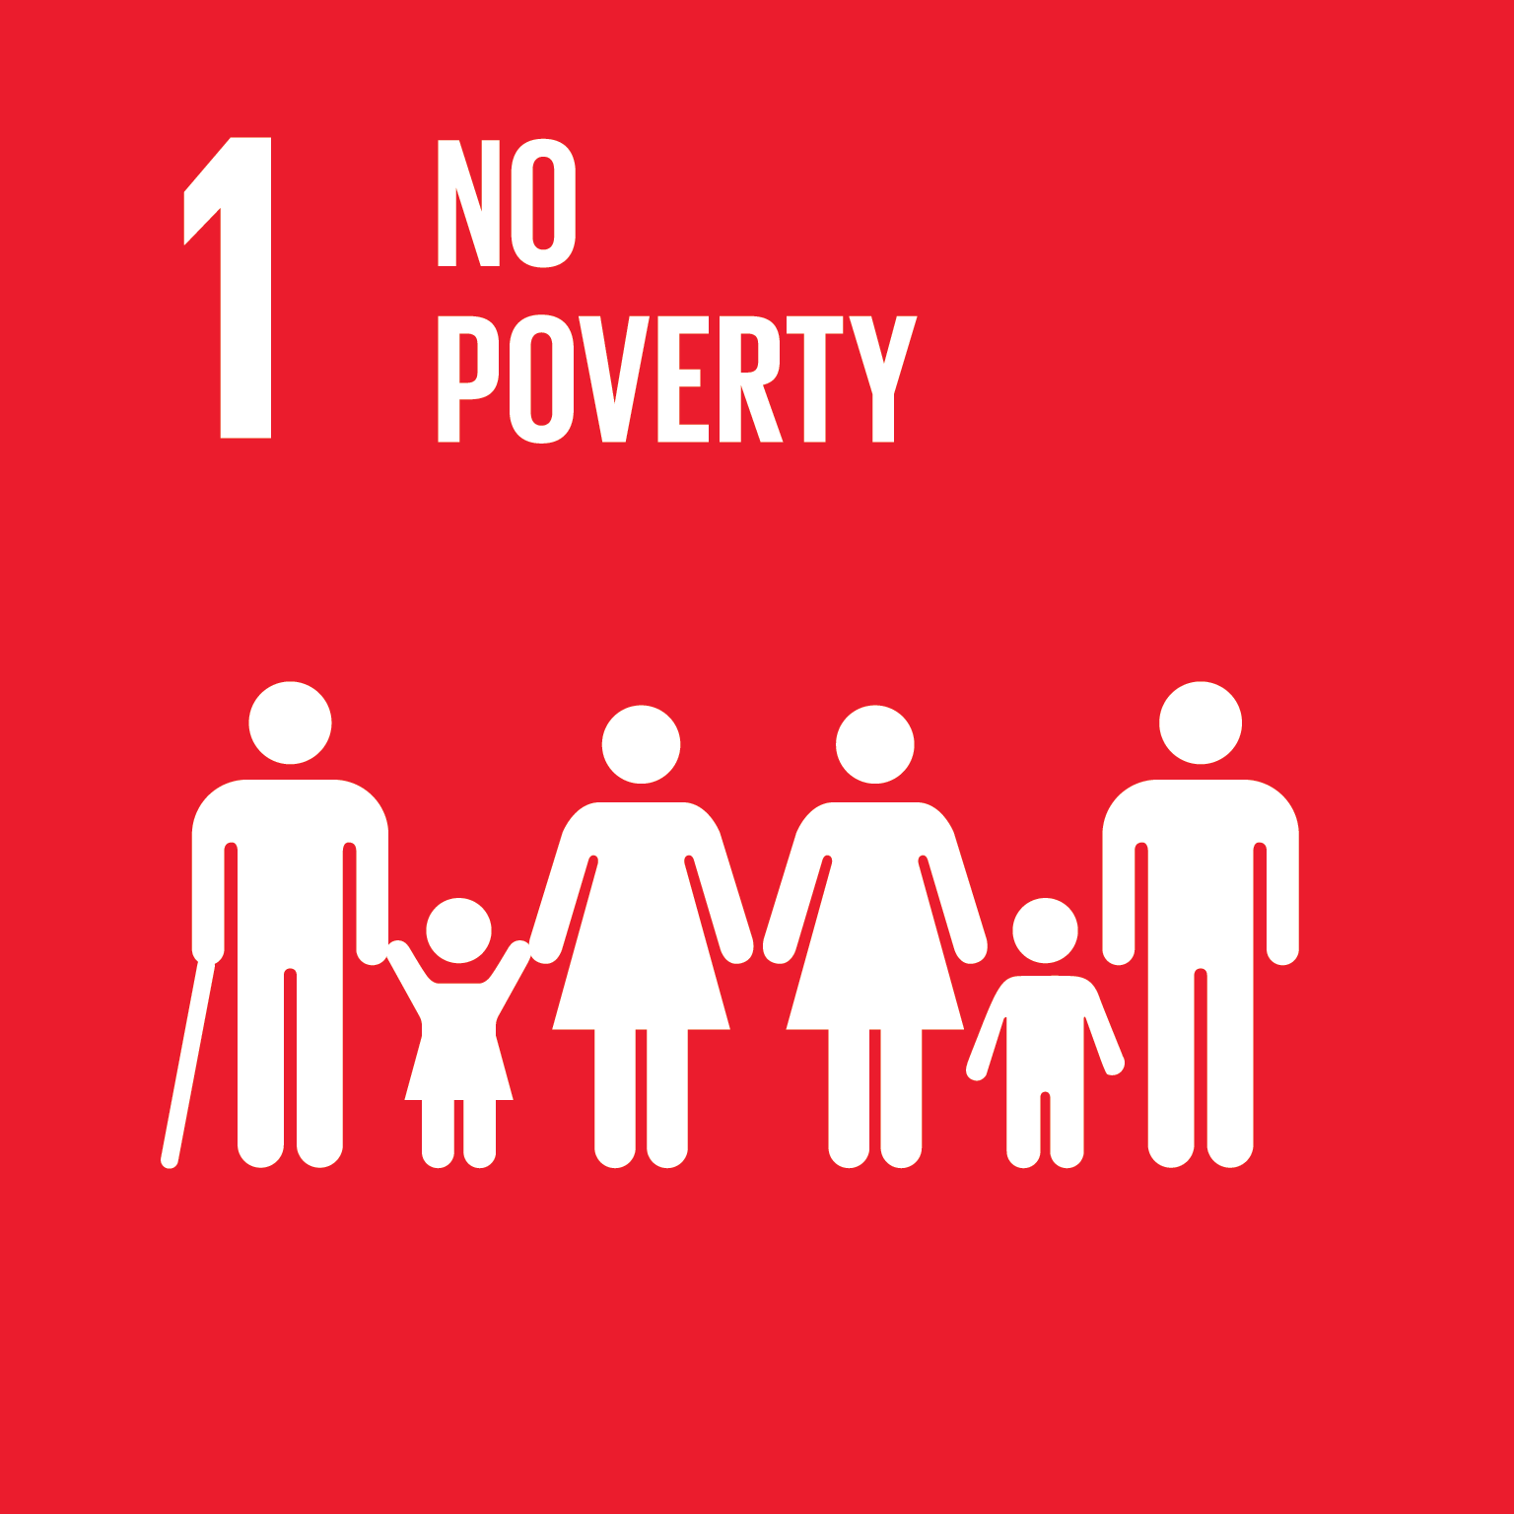
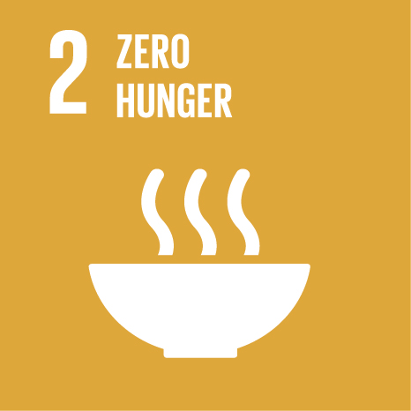
UN Sustainable Development Goals

Slide 18


UN Sustainable Development Goals

Slide 19
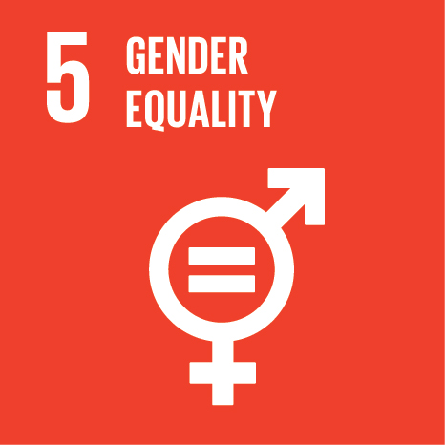
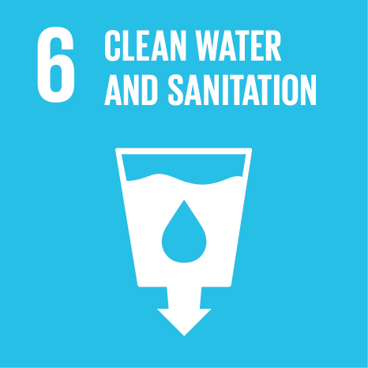
UN Sustainable Development Goals

Slide 20
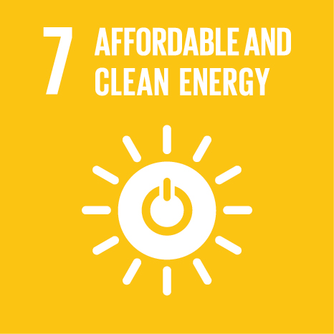
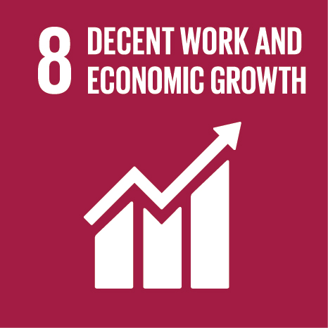
UN Sustainable Development Goals

Slide 21
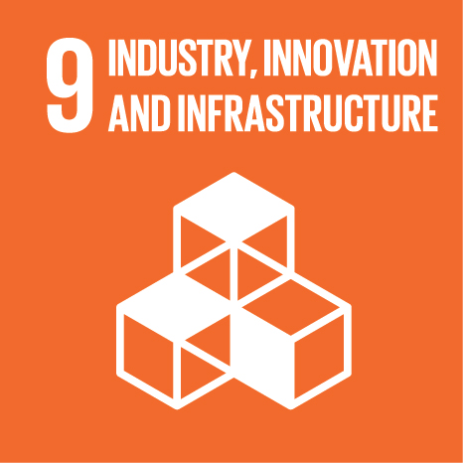
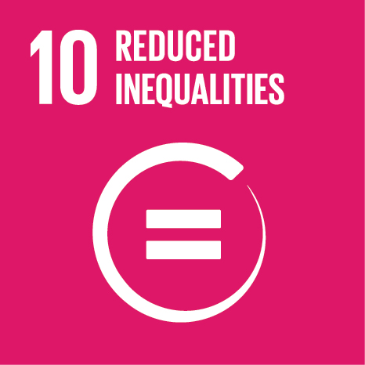
UN Sustainable Development Goals

Slide 22
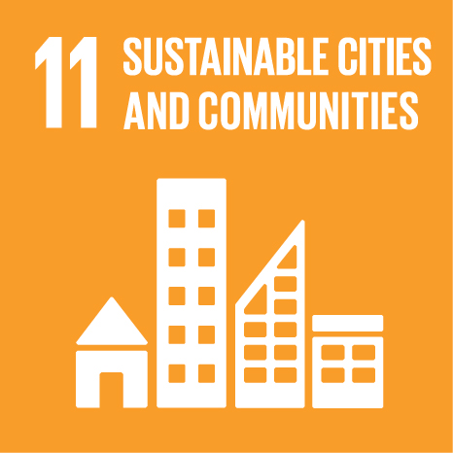
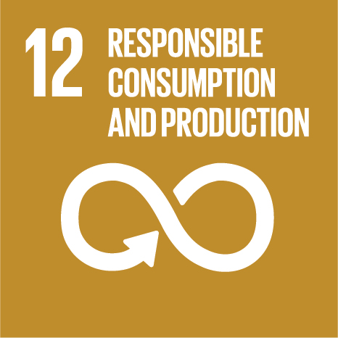
UN Sustainable Development Goals

Slide 23
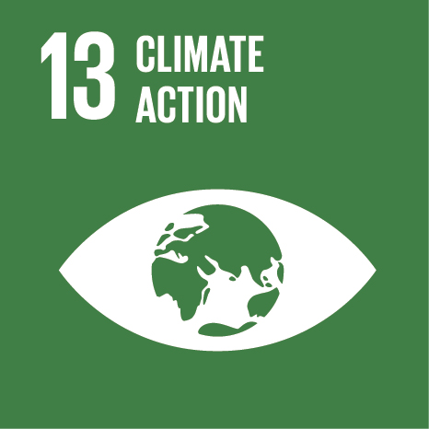
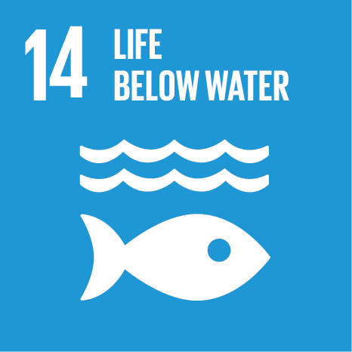
UN Sustainable Development Goals

Slide 24
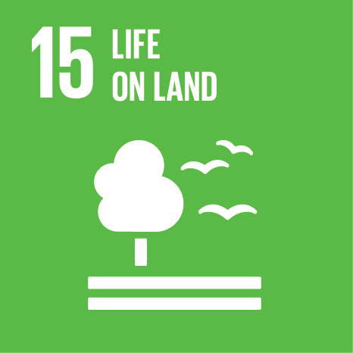

UN Sustainable Development Goals

Slide 25


UN Sustainable Development Goals

Slide 26
Sustainable Development Domains
Scheme of sustainable development: at the confluence of three constituent parts. (2006)Sustainable development, or sustainability, has been described in terms of three spheres, dimensions, domains or pillars, i.e. the environment, the economy and society.
The three-sphere framework was initially proposed by the economist René Passet in 1979.

Slide 27
Sustainable Development Domains
It has also been worded as "economic, environmental and social" or "ecology, economy and equity".
This has been expanded by some authors to include a fourth pillar of culture, institutions or governance, or alternatively reconfigured as four domains of the social - ecology, economics, politics and culture, thus bringing economics back inside the social, and treating ecology as the intersection of the social and the natural.

Slide 28
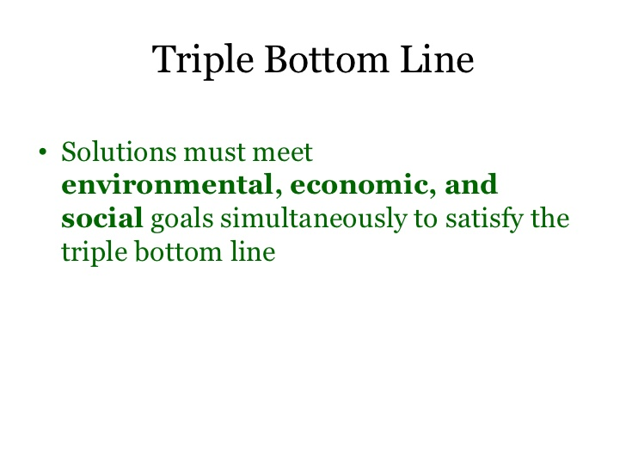

Slide 29
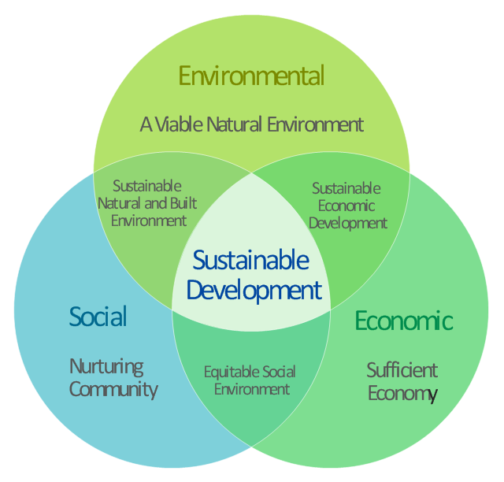

Slide 30
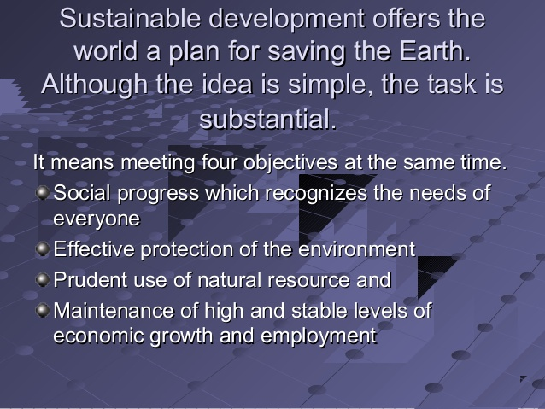

Slide 31
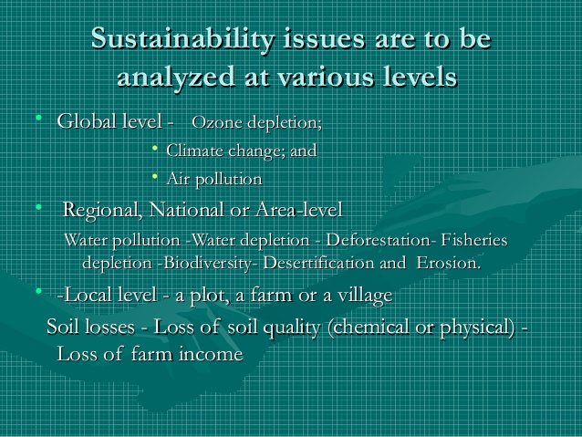

Slide 33
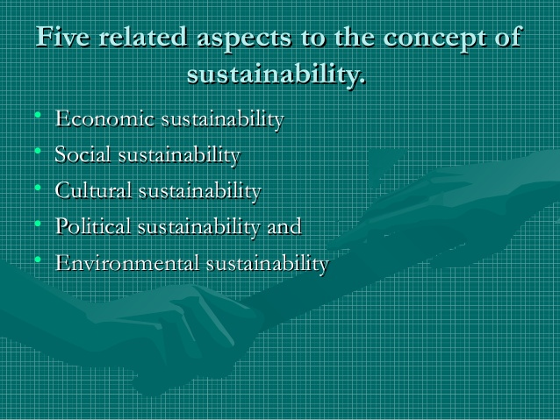

Slide 34
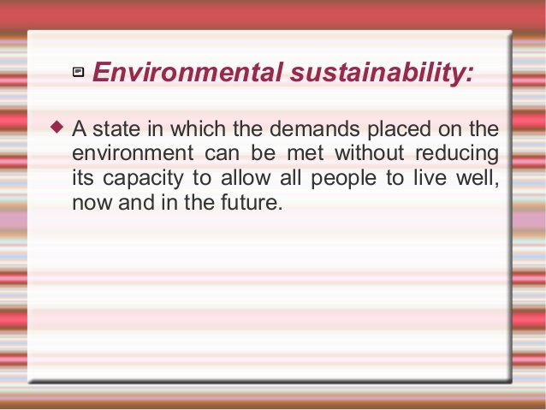

Slide 35
Sustainable Development (SD)
Environmental sustainability requires society to design activities to meet human needs while preserving the life support systems of the planet.
This, for example, entails using water sustainably, utilizing renewable energy, and sustainable material supplies (e.g. harvesting wood from forests at a rate that maintains the biomass and biodiversity).

Slide 36
Sustainable Development (SD)
Since natural resources are derived from the environment, the state of air, water, and the climate are of particular concern.
The IPCC Fifth Assessment Report outlines current knowledge about scientific, technical and socio-economic information concerning climate change, and lists options for adaptation and mitigation.

Slide 37
Sustainable Development (SD)
An unsustainable situation occurs when natural capital (the sum total of nature's resources) is used up faster than it can be replenished.
Sustainability requires that human activity only uses nature's resources at a rate at which they can be replenished naturally.

Slide 38
Sustainable Development (SD)
Such degradation on a global scale should imply an increase in human death rate until population falls to what the degraded environment can support.
If the degradation continues beyond a certain tipping point or critical threshold it would lead to eventual extinction for humanity.

Slide 39
Sustainable Development (SD)
Environmental sustainability requires society to design activities to meet human needs while preserving the life support systems of the planet.
This, for example, entails using water sustainably, utilizing renewable energy, and sustainable material supplies (e.g. harvesting wood from forests at a rate that maintains the biomass and biodiversity).

Slide 40
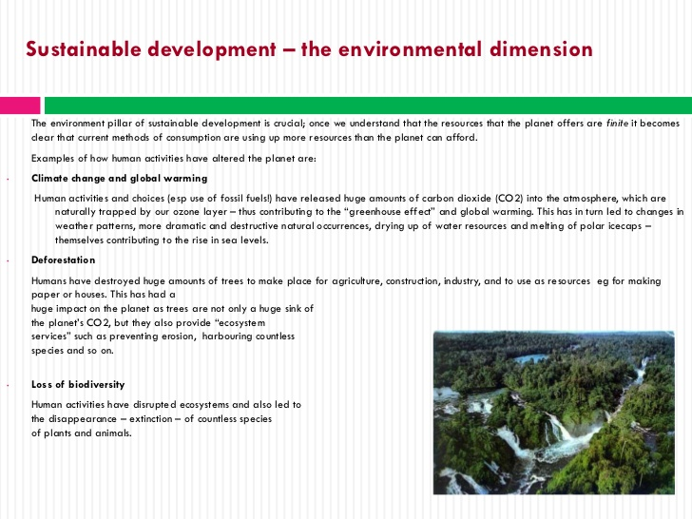

Slide 41
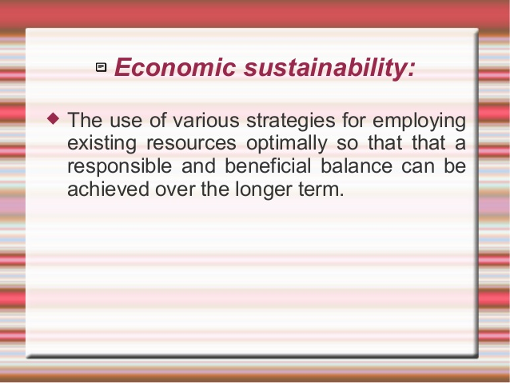

Slide 42
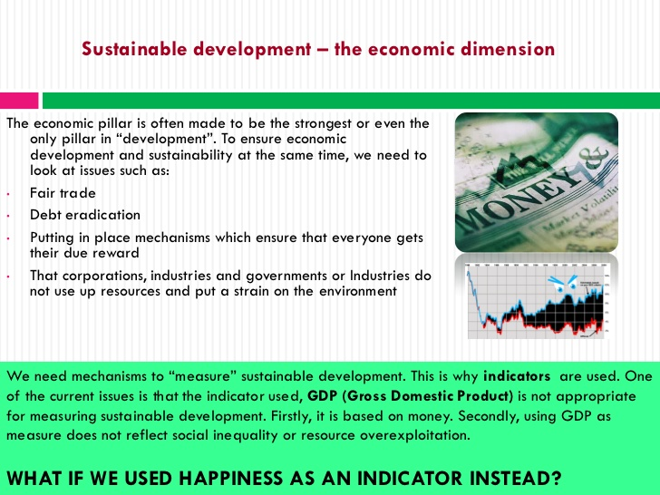

Slide 43
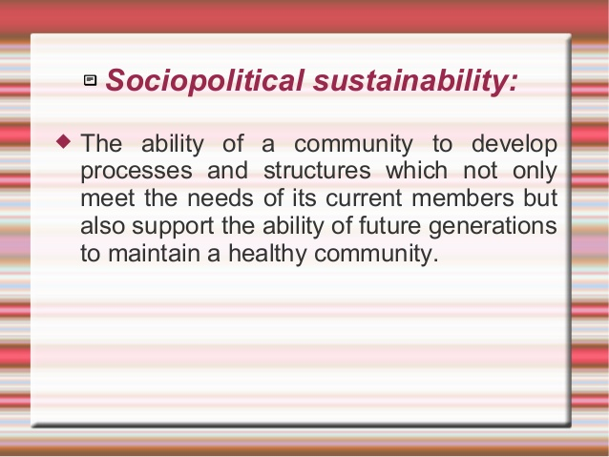

Slide 44
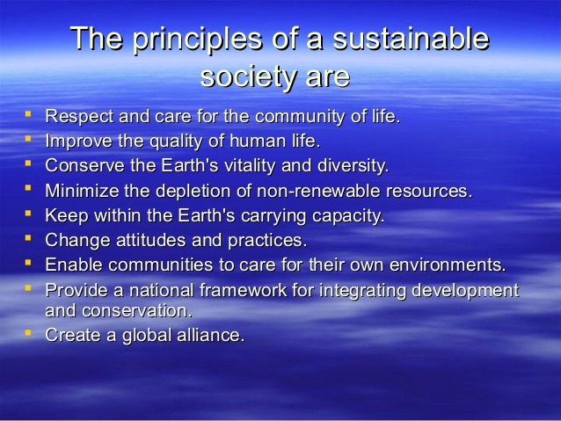

Slide 45
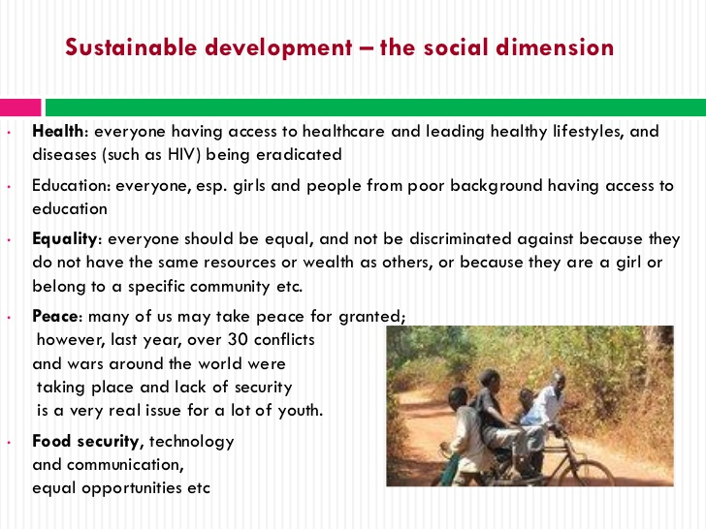

Slide 46
Sustainable Development (SD)
These can be either positive (e.g. corporate giving, creation of employment) or negative (e.g. work accidents, mobbing of employees, human rights abuses).
Depending on the type of impact socio-efficiency thus either tries to minimize negative social impacts (i.e. accidents per value added) or maximise positive social impacts (i.e. donations per value added) in relation to the value added.

Slide 47
Sustainable Development (SD)
Agriculture
Sustainable agriculture consists of environmentally-friendly methods of farming that allow the production of crops or livestock without damage to human or natural systems such as soil, water, biodiversity, and surrounding resources
—as well as to those working or living on the farm or in neighboring areas.

Slide 48
Sustainable Development (SD)
The concept of sustainable agriculture extends inter-generationally, passing on a conserved or improved natural resource, biotic, and economic base rather than one which has been depleted or polluted.
Elements of sustainable agriculture include permaculture, agroforestry, mixed farming, multiple cropping, and crop rotation, organic farming, use of manure/compost, etc.

Slide 49
Sustainable Development (SD)
Energy
Sustainable energy is clean and can be used over a long period of time. Unlike fossil fuels that most countries are using, renewable energy only produces little or even no pollution.
The most common types of renewable energy are hydroelectric, solar and wind energy; solar energy can commonly be used for heating water, street lights and lighting in houses.Wind power has expanded quickly, it's share of worldwide electricity usage at the end of 2014 was 3.1%.

Slide 50
Sustainable Development (SD)
Business
The most broadly accepted criterion for corporate sustainability constitutes a firm’s efficient use of natural capital. This eco-efficiency is usually calculated as the economic value added by a firm in relation to its aggregated ecological impact.

Slide 51
World Business Council for Sustainable Development (WBCSD)
This idea has been popularized by the World Business Council for Sustainable Development (WBCSD) under the following definition:
"Eco-efficiency is achieved by the delivery of competitively priced goods and services that satisfy human needs and bring quality of life, while progressively reducing ecological impacts and resource intensity throughout the life-cycle to a level at least in line with the earth’s carrying capacity."

Slide 52
Sustainable Development (SD)
Business
The most broadly accepted criterion for corporate sustainability constitutes a firm’s efficient use of natural capital. This eco-efficiency is usually calculated as the economic value added by a firm in relation to its aggregated ecological impact.

Slide 53
Sustainable Development (SD)
Business
This idea has been popularised by the World Business Council for Sustainable Development (WBCSD) under the following definition:
"Eco-efficiency is achieved by the delivery of competitively priced goods and services that satisfy human needs and bring quality of life, while progressively reducing ecological impacts and resource intensity throughout the life-cycle to a level at least in line with the earth’s carrying capacity." (DeSimone and Popoff, 1997: 47)

Slide 54
Sustainable Development (SD)
Similar to the eco-efficiency concept but so far less explored is the second criterion for corporate sustainability.
Socio-efficiency describes the relation between a firm's value added and its social impact.
Whereas, it can be assumed that most corporate impacts on the environment are negative (apart from rare exceptions such as the planting of trees) this is not true for social impacts.

Slide 55
Sustainable Development (SD)
Similar to the eco-efficiency concept but so far less explored is the second criterion for corporate sustainability. Socio-efficiency describes the relation between a firm's value added and its social impact.
Whereas, it can be assumed that most corporate impacts on the environment are negative (apart from rare exceptions such as the planting of trees) this is not true for social impacts.

Slide 56
Sustainable Development (SD)
These can be either positive (e.g. corporate giving, creation of employment) or negative (e.g. work accidents, mobbing of employees, human rights abuses).
Depending on the type of impact socio-efficiency thus either tries to minimize negative social impacts (i.e. accidents per value added) or maximise positive social impacts (i.e. donations per value added) in relation to the value added.

Slide 57
Sustainable transport
Sustainable transport refers to the broad subject of transport that is sustainable in the senses of social, environmental and climate impacts and the ability to, in the global scope, supply the source energy indefinitely.
Components for evaluating sustainability include the particular vehicles used for road, water or air transport; the source of energy; and the infrastructure used to accommodate the transport (roads, railways, airways, waterways, canals and terminals).

Slide 58
Sustainable transport systems
Sustainable transport systems make a positive contribution to the environmental, social and economic sustainability of the communities they serve.
Transport systems exist to provide social and economic connections, and people quickly take up the opportunities offered by increased mobility, with poor households benefiting greatly from low carbon transport options.
The advantages of increased mobility need to be weighed against the environmental, social and economic costs that transport systems pose.

Slide 59
Sustainable Development (SD)
Architecture
In sustainable architecture the recent movements of New Urbanism and New Classical architecture promote a sustainable approach towards construction, that appreciates and develops smart growth, architectural tradition and classical design.

Slide 60
Sustainable Development (SD)
Architecture
In sustainable architecture the recent movements of New Urbanism and New Classical architecture promote a sustainable approach towards construction, that appreciates and develops smart growth, architectural tradition and classical design.
This in contrast to modernist and International Style architecture, as well as opposing to solitary housing estates and suburban sprawl, with long commuting distances and large ecological foot prints. Both trends started in the 1980s.
It should be noted that sustainable architecture is predominantly relevant to the economics domain while architectural landscaping pertains more to the ecological domain.

Slide 61
Architecture
This in contrast to modernist and International Style architecture, as well as opposing to solitary housing estates and suburban sprawl, with long commuting distances and large ecological foot prints. Both trends started in the 1980s.
It should be noted that sustainable architecture is predominantly relevant to the economics domain while architectural landscaping pertains more to the ecological domain.

Slide 62
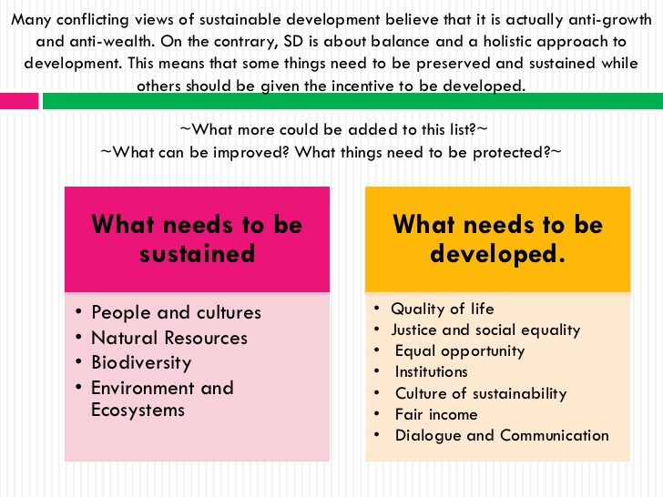

Slide 63
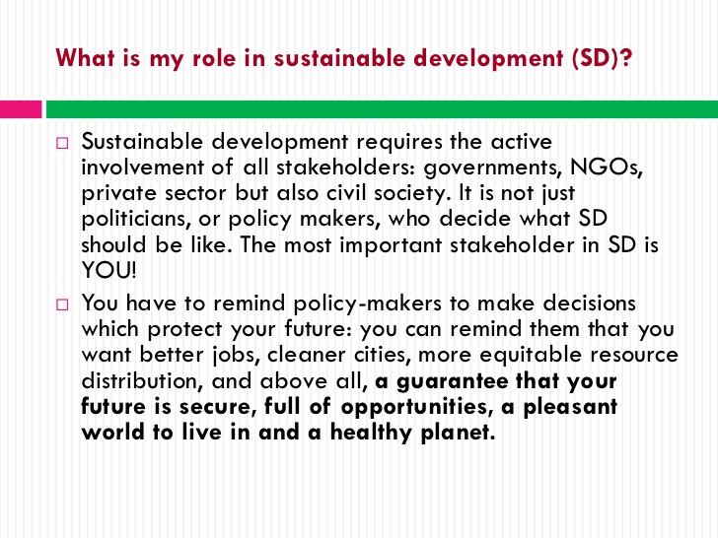

Slide 64
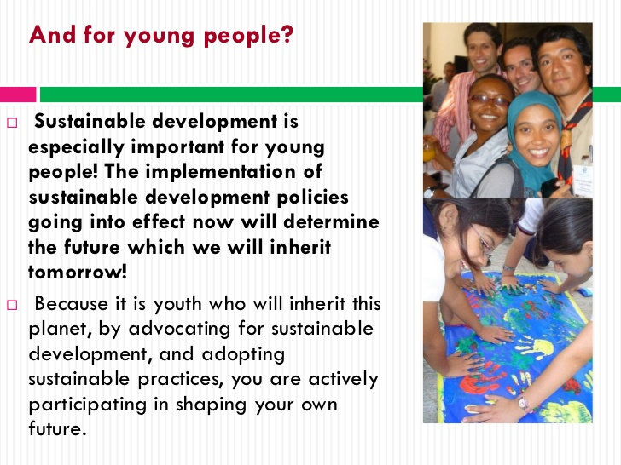

Slide 65
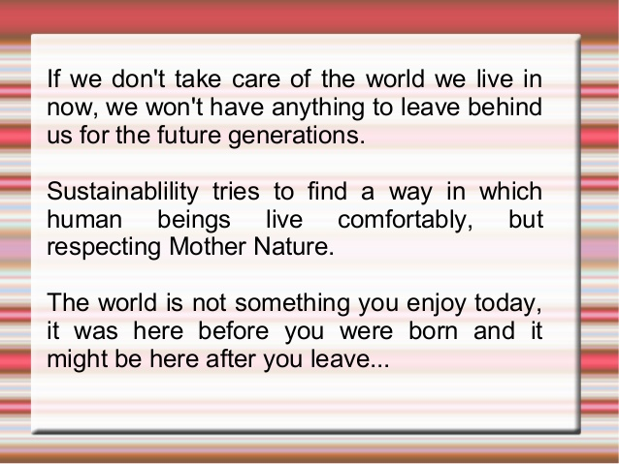

Slide 66

Let’s make a beginning……!!!!!

